Slide 1
Case-control Studies Design and Conduct
This is the development version of the lab warm-up. Erase this text box, erase all comments, and “save as” to create the version shared with students.
Or, just move slides over to the production version one at a time as you complete changes to them.
Notes:
This week we’re discussing case-control studies.

Slide 2
Measures
Observations
Experiments
Case
Descriptions
Ecological
Cross-sectional
Case-control
Cohort
Non-randomized
Randomized
Typically less convincing
Typically more convincing
Notes:
Today we are going to continue learning about different study designs by beginning a discussion about case-control studies.
Now, as you can see in the diagram above, results we get from case-control studies are sometimes seen as less convincing, or “weaker evidence”, than those we get from a cohort study. I think this is primarily a result of the perception that selection bias and recall bias are more likely to occur in a case-control study than in a cohort study. And, there is some evidence that may actually be true.
However, we’ve already seen that selection bias can also occur in cohort studies. Further, recall and other forms of information bias can also occur in cohort studies.
And, properly designed and executed case-control studies may be viewed as highly efficient special cases of cohort studies, which I’ll expand on soon.
So, the bottom line is that it probably isn’t helpful to think of case-control studies as universally “weaker” than cohort studies. I think it’s more useful to think of both as being able to produce useful, relatively unbiased results when properly designed and executed. Alternatively, it’s also possible for both to produce misleading, biased results when improperly designed or executed.
** Socrative 1

Slide 3
Basic cohort study design
Outcome Measured
in Exposed
👩🏽‍⚕️👨‍🔬
Cohort Identified
Exposure Measured
Incidence Proportion
Exposure Occurrence
Compare Incidence Proportion
Outcome Measured
in Unexposed
Incidence Proportion
Where:
Orange = Exposed
Blue = Unexposed
Circle = No Outcome
Triangle = Outcome
Time
Notes:
Here’s my little graphical representation of the basic prospective cohort design. Exposures that we are interested in occur out in the world. Then, we come along and measure these exposures and classify a group of people (a cohort) as exposed or unexposed. Then, we let some time pass, and we see if more exposed people or more unexposed people develop the outcomes we are interested in. Pretty clean and simple (at least in theory).
Where:
Orange = Exposed to vaccine
Blue = Unexposed to vaccine
Circle = No Flu
Triangle = Flu

Slide 4
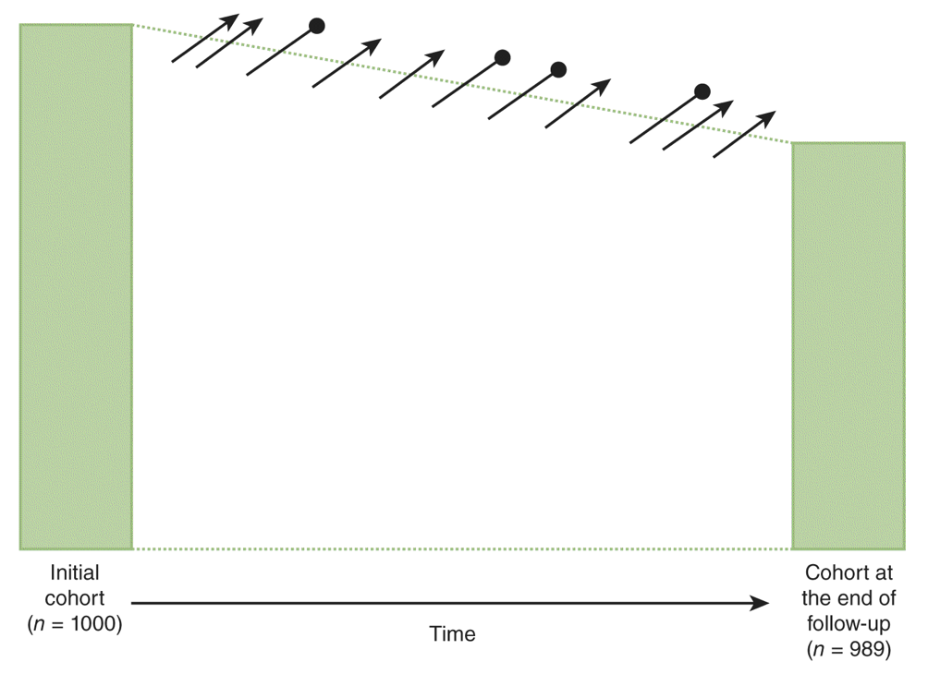
Notes:
And here is how the textbook draws it.
Now, the nice thing about this design is its simplicity. It makes intuitive sense. But, what if are interested in understanding an outcome that doesn’t occur very often, or a lot of time has to pass before it occurs, or both? In either case, this design isn’t very efficient. Meaning, we’d need to study a ton of people -- possibly for a very long time -- before we can make the risk comparisons we are interested in.
In those cases, wouldn’t it be nice if we could just skip to the end of the cohort study where we already know if people get the outcome or not, and then figure out if they were exposed? In theory, we could still see if more exposed people or more unexposed people develop the outcome we are interested in.

Slide 5
Basic case-based case-control study design
Population of interest
Cases Identified
Exposure Measured
Calculate Odds
Compare Odds
Controls Identified
Exposure Measured
Calculate Odds
Time
Notes:
Here’s my little graphical representation of the basic case-based case-control study design. There are other case-control designs, but when someone simply says, “case-control” study, this is probably what they are talking about.
In this design, exposures and outcomes that we are interested in occur out in the world. Then, we come along and gather up a group of people who have already had the outcome we are interested in and then measure their history of exposures(s). Similarly, we gather up a group of people who we think are comparable to the people with the outcome in all relevant ways, but who haven’t had the outcome, and we also measure their history of exposure(s). Finally, we calculate the odds of being exposed in both groups and compare.
Where:
Orange = Exposed to smoking
Blue = Unexposed to smoking
Circle = No lung cancer
Triangle = Lung cancer
This is a very simplistic description, but it’s intended to just give you an intuitive feel for what we are talking about.

Slide 6
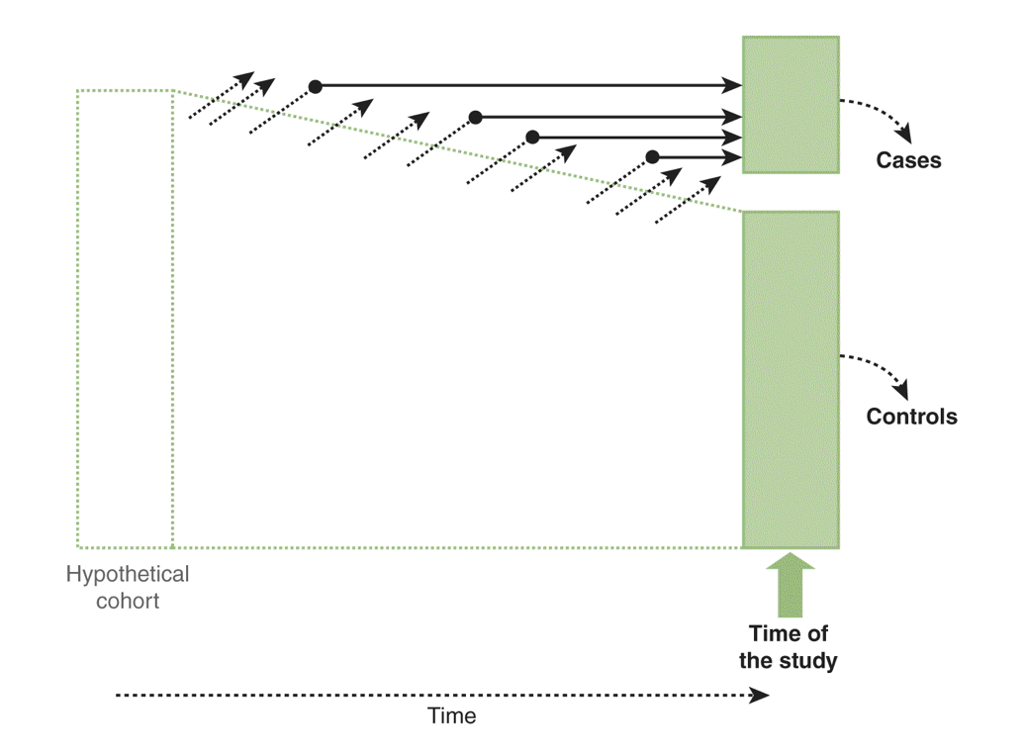
Notes:
And once again, this is how your textbook represents the case-based case-control study design graphically.
Note, that they have “hypothetical cohort” written on the left-hand side. They do this to reinforce the idea that a properly designed and executed case-control study can be thought of as a more efficient version of a cohort study. However, there are various forms of bias that have to potential to lead us to get very different results from our case-control study than we would have gotten from a cohort study designed to answer the same research question. We’ll talk more about them shortly.

Slide 7
Case-control Studies
Observational design
The basic idea
Select participants based on their outcome status as cases and controls.
“Look” backwards to measure their past exposure status.
The odds of past exposure to a suspected risk factor are compared among cases and controls for a specific period of time.
When to Use
Highly efficient when disease is rare or takes a long time to develop.
Study the effect of multiple exposures on an outcomes (e.g., outbreak investigations)
Notes:
So, let’s pause here and do a quick recap.

Slide 8
Study Base Principle
Cases and controls should be “representative of the same base experience.”
If a potential control had gotten the disease they would have been selected with the same probability as any other case
If this is not true you have selection bias!
Primary vs secondary base
Primary base defined by population under study
Population based studies
Difficult to get every case
Secondary base defined by case definition
Study base are those who would have been selected as cases if they developed the disease
Hospital based studies
Notes:
Now that we have the basic gist of what case-control studies are, let’s discuss some of the aspects of case-control studies that tend to determine how biased the results we get from them will or won’t be.
Let’s start by discussing the study base principle. The study base principle is one of the most fundamental concepts in case-control studies. It essentially means…
In other words, we don’t want to compare two different populations of people (with respect to the disease(s) of interest), we want to compare two groups (cases and controls) within a single population.
** Socrative 2

Slide 9
Selecting cases
Case definitions should be set up in such a way that the cases exclusively consist of all (or a random sample of) subjects experiencing the study outcome in the study base.
Notes:
So, we have our study base, which is ideally our population of interest or a good proxy for our population of interest. The next step is to select our cases…

Slide 10
Selecting cases
Establish objective eligibility criteria
Use incident cases when possible
Can’t distinguish between effects on incidence and duration (survival) when using prevalent cases
Must consider conceptual vs. operational definition of a case
Conceptual vs operational
Comparing conceptual definition to operational definition can reveal potential bias
Conceptual definition of HIV: a person who would test positive for HIV if given the test
Operational definition of HIV: a person who has taken the test and tested positive for HIV
Who decides to get a test?
Who has access to test?
What is the sensitivity and specificity of the test?
Notes:
And how do we do that?

Slide 11
Source of Cases (Disease-dependent)
Hospital-based
Admissions logs
Record of discharge diagnosis
Population-based
Disease registries
Vital statistics registries
Other sources
Notes:
And where do we find cases?

Slide 12
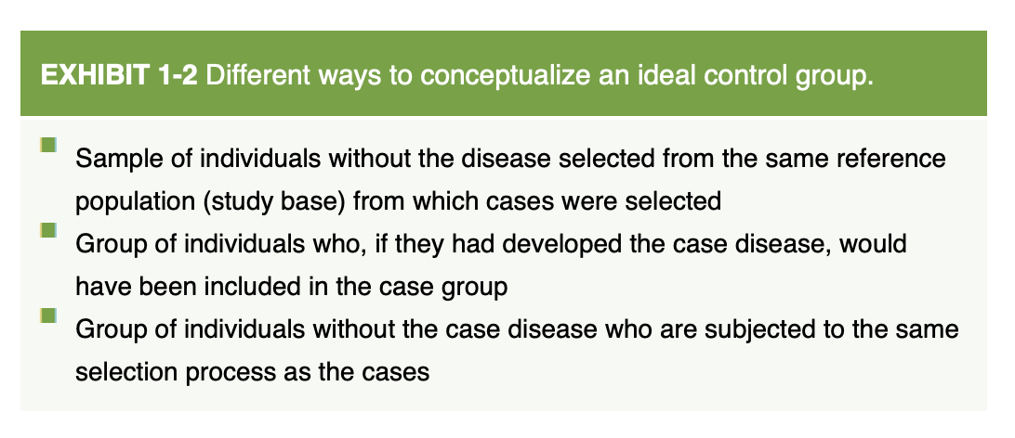
Selection of controls
Control selection is by far the most difficult part of conducting a case control study

Slide 13
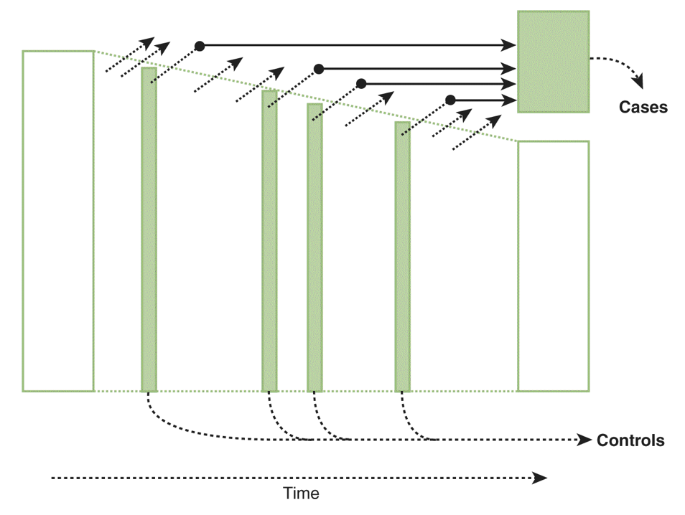
Nested case-control study design
Notes:
One way we can make this a little easier is to use a nested case-control or case-cohort design.﻿
In a nested case-control design, controls are a random sample of the individuals remaining in the cohort at the time each case occurs. This design is based on a sampling approach known as incidence density sampling or risk-set sampling. Cases are compared with a subset (a sample) of the “risk set,” that is, the cohort members who are at risk (i.e., who could become a case) at the time when each case occurs. By using this strategy, cases occurring later in the follow-up are eligible to be controls for earlier cases. Incidence density sampling is the equivalent of matching cases and controls on duration of follow-up and permits the use of straightforward statistical analysis techniques (e.g., standard multiple regression procedures for the analysis of matched and survival data).
Szklo, Moyses,Nieto, F. Javier. Epidemiology (Kindle Locations 857-864). Jones & Bartlett Learning. Kindle Edition.

Slide 14
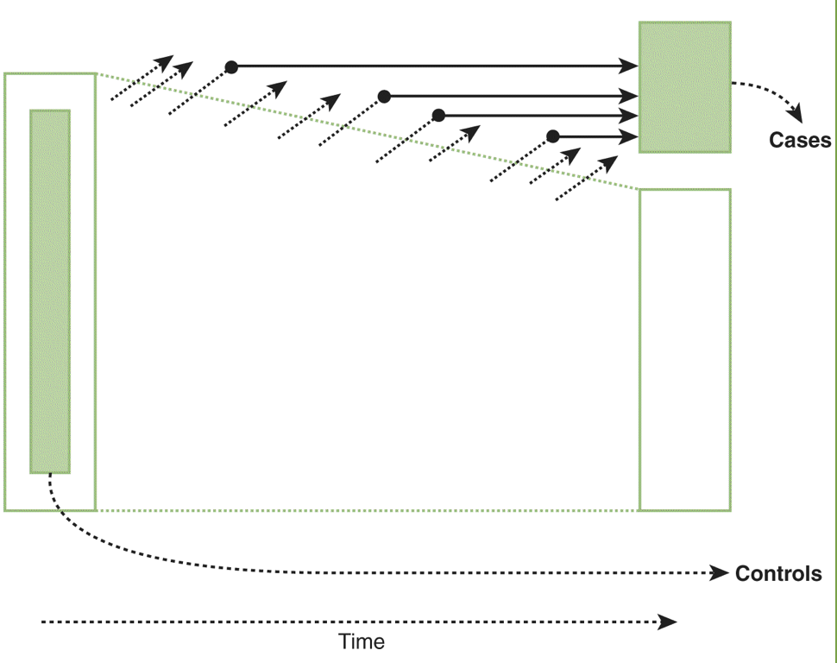
Case-cohort study design
Notes:
Another option is to use the case-cohort design. In the case-cohort design, controls are selected as a random sample of the total cohort at baseline. In this design, the control group may include individuals who become cases during the follow-up (diagonal lines ending with a dot). Because of the potential overlap between the case and the cohort random sample (control) groups, special techniques are needed for the analysis of this type of study.
An important advantage of the case-cohort design is that a sample of the baseline cohort can serve as a control group for different sets of cases occurring in the same cohort.
Szklo, Moyses,Nieto, F. Javier. Epidemiology (Kindle Locations 867-873). Jones & Bartlett Learning. Kindle Edition.

Slide 15
Selection Bias in Case Control Studies
Selection bias can happen in a variety of ways in case control studies when the study base principle is violated
Differential surveillance
Differential diagnosis
Referral patterns
All of these can lead to differential selection rates by exposure which will in turn lead to selection bias

Slide 16
Information Bias in Case Control Studies
Interviewer bias
Systematic error in soliciting, recording or interpreting information from study subjects based on their exposure/disease status
Blind interviewers to disease status
Recall bias
Inaccurate recall of exposure status in either cases or controls
Can’t blind cases to their case status
Verify participant response when able
Reporting bias
Social desirability

Slide 17
Control confounding
Analysis (next week)
Matching
Individually matched (one-to-n)
Frequency matched
Propensity score matching
Notes:
Control group selection can also be used to minimize bias from unmeasured confounders. Easily measurable confounders can be measured and controlled for in the analysis, but when a confounder cannot be measured, matched control group selection should seek to minimize the variability of the confounder.
** Socrative 3

